Slide 1
Data_Science JOB_Salaries_Comparison

Slide 2
Project Overview
In today’s data-driven economy, the demand for data science professionals is rising rapidly across industries. However, salaries for data science roles vary widely depending on factors such as location, experience, skills, and industry sector. Understanding these variations can help job seekers, employers, and educational institutions make more informed decisions. This project aims to analyze data science job salary trends using Python.
Python serves as the primary tool for this analysis due to its robust ecosystem of data science libraries. We use pandas for data manipulation, matplotlib and seaborn for visualizations, and scikit-learn for optional predictive modeling. The project includes steps like data cleaning, exploratory data analysis (EDA), and visual storytelling to uncover key insights and salary patterns in the data science field.

Slide 3
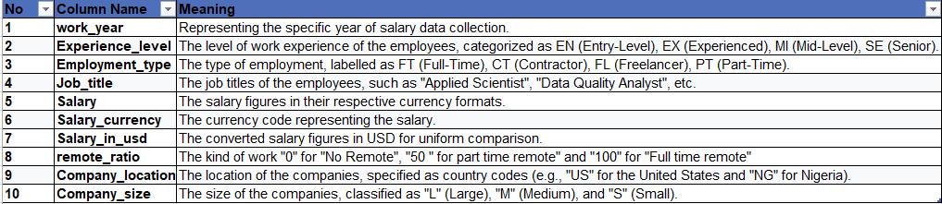
Data Exploration
Dataset contains 607 rows and 10 columns

Slide 4

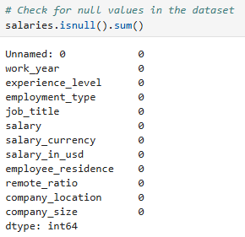
Data preprocessing
To check for duplicates
To check for Null values
Observation:
We do not find any duplicates in the dataset
We do not observe any null values in the dataset.
Let us start with Exploratory data analysis.

Slide 5
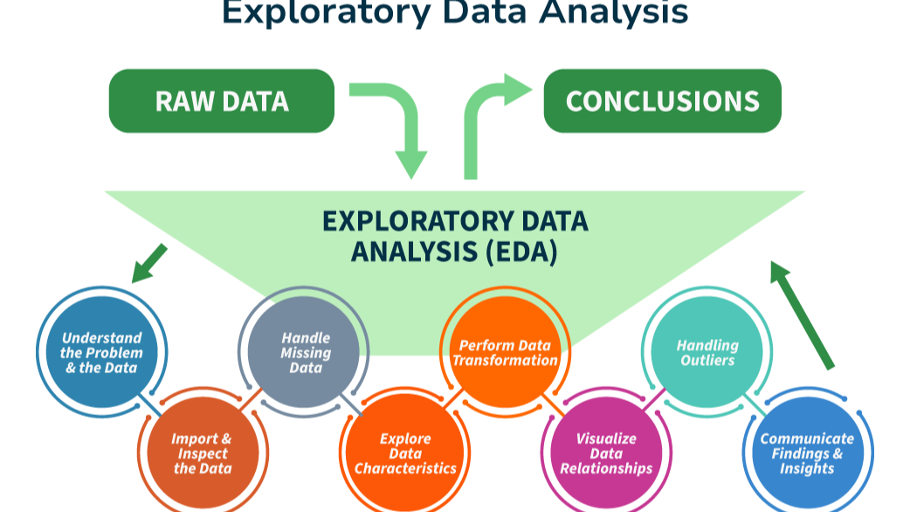
Exploratory Data Analysis (EDA)

Slide 6
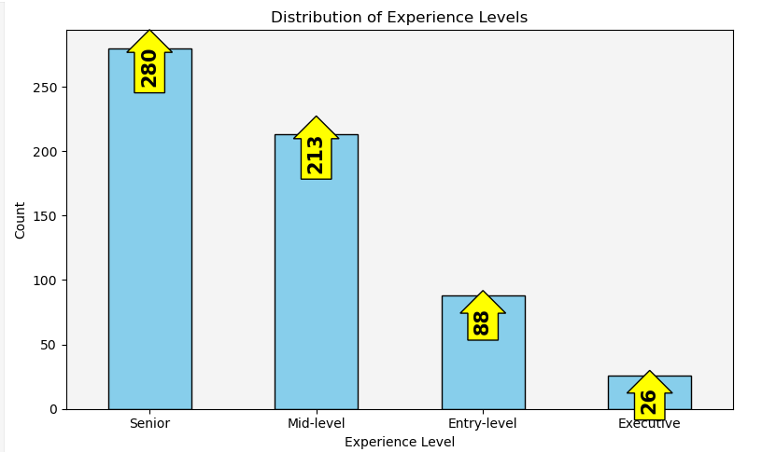
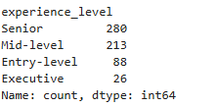
Count of employees by experience level

Slide 7
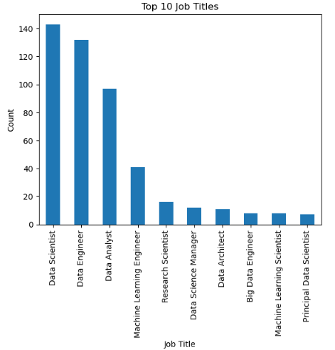
Top 10 Job titles

Slide 8
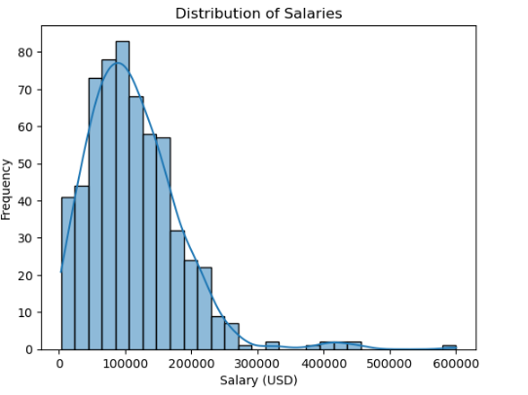
Distribution of salaries
Most salaries are concentrated between $50,000 and $150,000, with fewer employees earning above $200,000—indicating a right-skewed distribution.

Slide 9
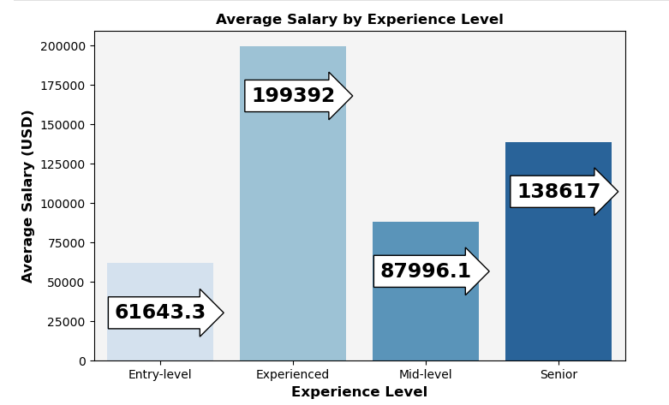
Average salary by experience level
Insights:
Experienced professionals earn more package when compared to senior and mid level professionals.

Slide 10
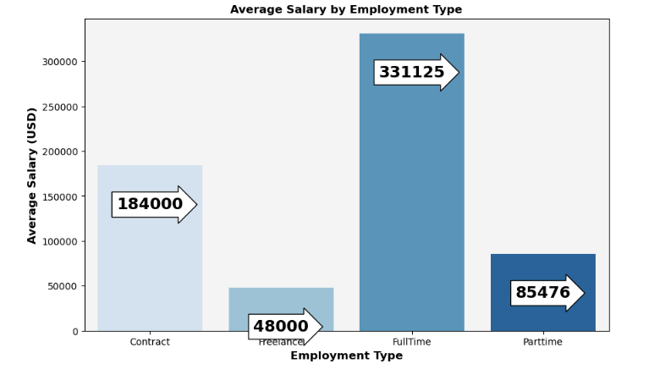
Average salary by employment type
Insight
Full-time employees typically receive higher compensation and better benefits compared to part-time or contract workers due to longer working hours and greater job stability.

Slide 11
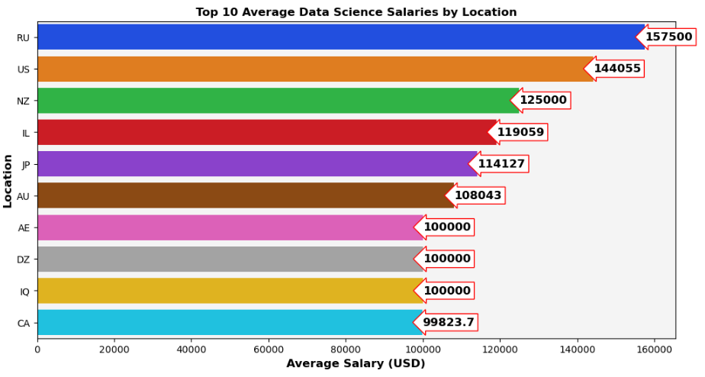
Top 10 average data science salaries by location
People in Russia and US earn notably high salary
Japan,New Zealand and Illinois have an average salary range of 110000$ to 125000$

Slide 12
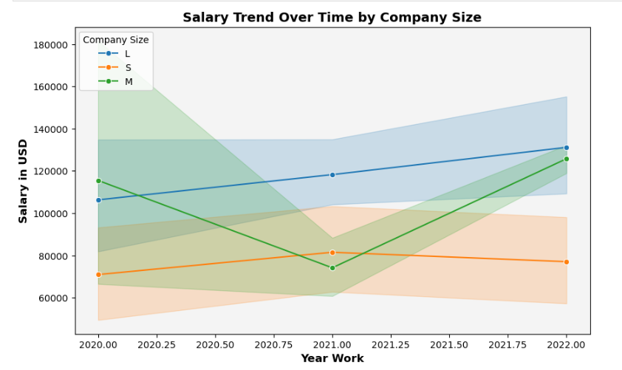
Salary Tend over company size

Slide 13
conclusion
Experienced professionals tend to earn more than mid- and senior-level employees.
Full-time Data Scientist roles are growing and are among the highest-paying jobs.
Large companies show stronger growth compared to medium and small firms.
Most professionals earn between $50,000 and $150,000.
Professionals in Russia and the US earn notably high salaries.
Japan, New Zealand, and Illinois report average salaries ranging from $110,000 to $125,000.

Slide 14
Thank you

